Slide 1


MICROSOFT 365 VIRTUAL MARATHON 2022
MAY, 4 – 6, 2022
DSC Framework – Your Automation Companion

Slide 2





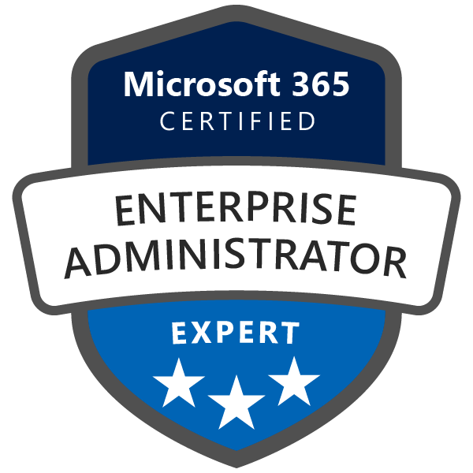
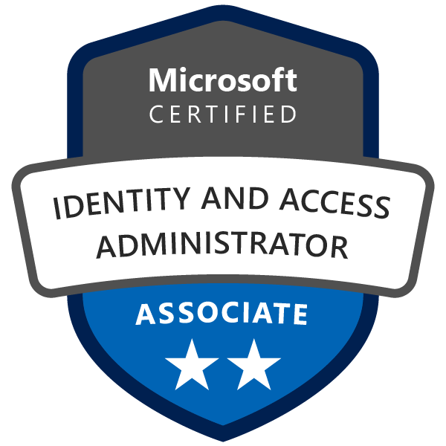
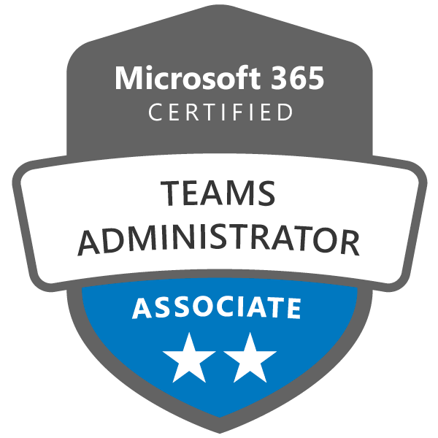

WHOAMI
Matteo ZAMORI
Modern Workplace Engineer
SharePoint Architect
Mr-W1nst0n
@mr_w1nst0n
matteozamori.com

Slide 3

Agenda
Basic Concepts of PowerShell DSC
Azure Automation DSC (AADSC)
Azure Policy Guest Configuration
M365DSC Toolkit
AzureDevOps Integration for CI/CD

Slide 4









MICROSOFT 365 VIRTUAL MARATHON 2022 SPONSORS

Slide 5


The Beginning
It’s a management platform built-in Windows PowerShell 4.0 and above (Windows OS life-cycle)
It’s using a declarative approach as alternative of standard PowerShell coding (imperative)
It’s supported across multiple Azure Services
It helps IT Administrators to automate configuration for Windows and Linux OS (Linux Not Native)
PSDesiredStateConfiguration v1.0 - Windows PowerShell 4.0
PSDesiredStateConfiguration v1.1 - Windows PowerShell 5.1
PSDesiredStateConfiguration v2.0 - PowerShell 7.0 (.NET Core)
PSDscResources v3.0 - PowerShell 7.2+ (.NET Core)
...

Slide 6
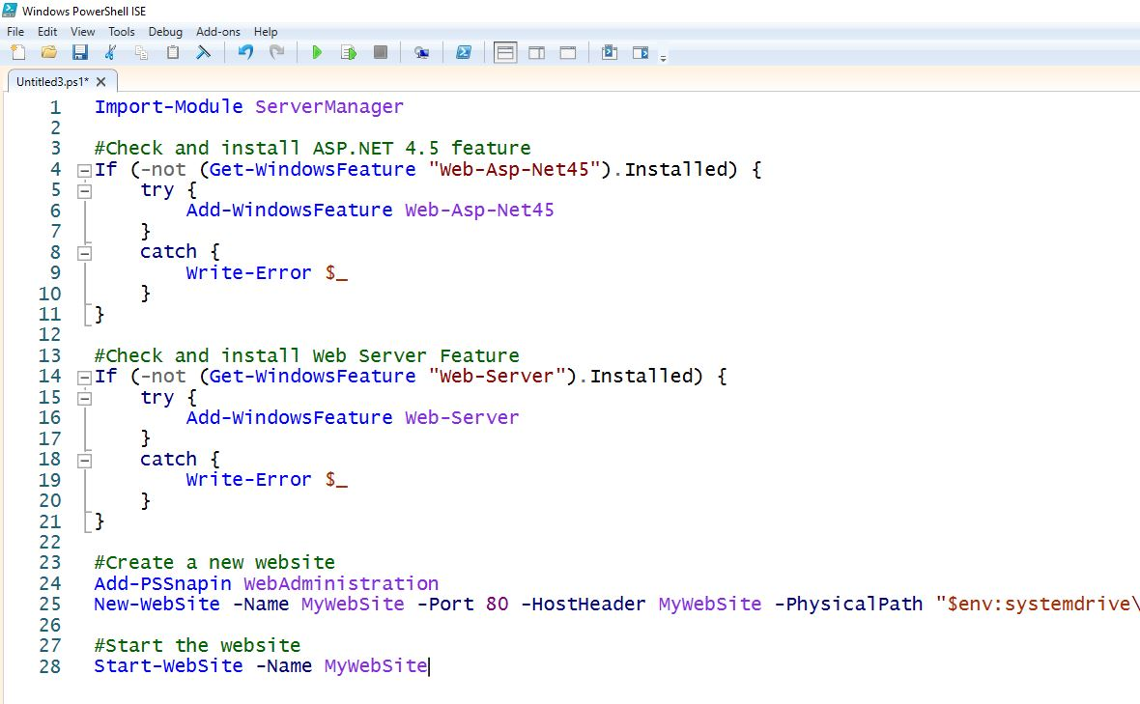
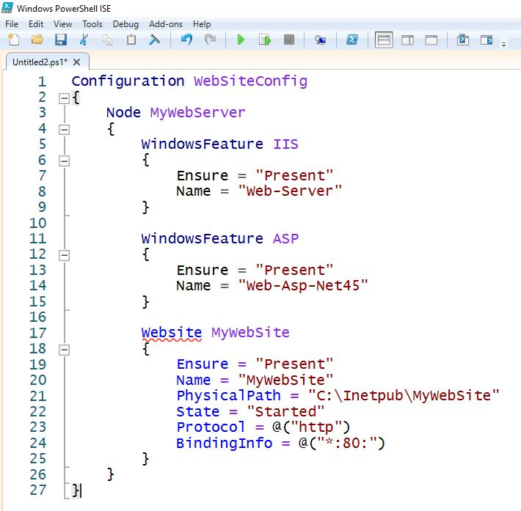
Imperative vs Declarative syntax
Imperative
Declarative

Slide 7

Key Terms and Definitions
Term | Short Description
DSC Configuration file | A PowerShell script that contains the core operations you want to perform
DSC Configuration data | A PowerShell data file where you defines information that are not unique and may change (Target Nodes, Customer information etc…)
DSC Resource | A PowerShell module that contains functions used by DSC
MOF File | A file that will be compiled with all the operations and that will be shipped on each Target Nodes
LCM | The DSC engine that control all executions made via DSC
Drift | A Term to indicate the difference between a previous state and the current state

Slide 8
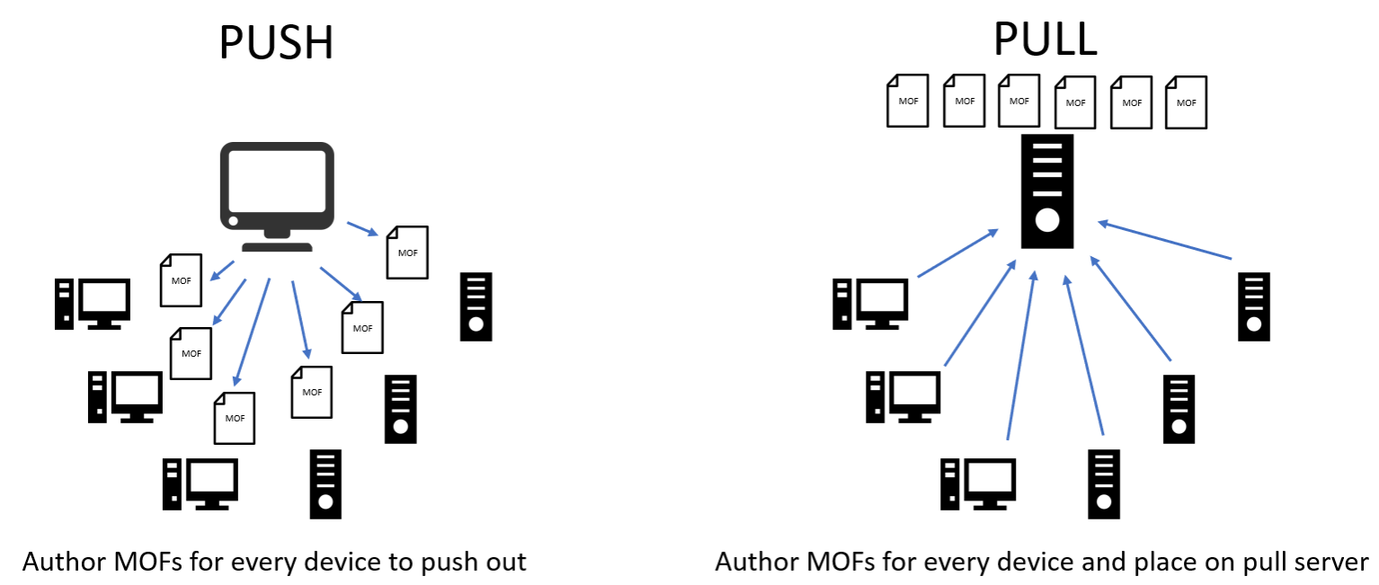
Desired State Configuration Models

Slide 9
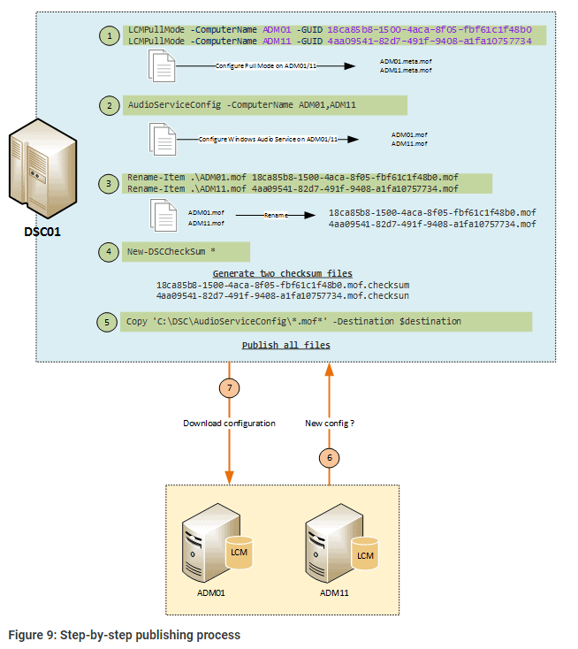
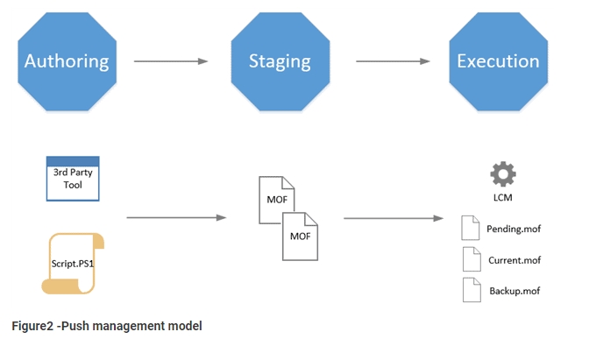
Desired State Configuration Push or Pull Model Phases

Slide 10
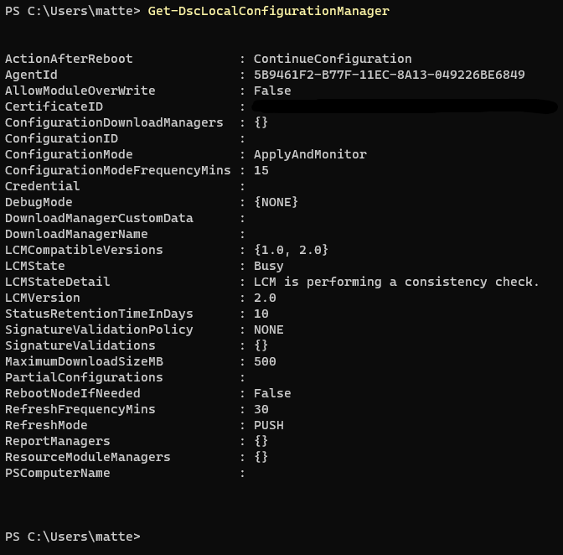
Local Configuration Manager (LCM) Mode
Drift Logged
Re-Apply the Desired Configuration
ApplyAndAutoCorrect
Contents
Drift Logged in the System
ApplyAndMonitor (Default)
Contents
No Drift check
ApplyOnly
Contents_Here
Contents

Slide 11
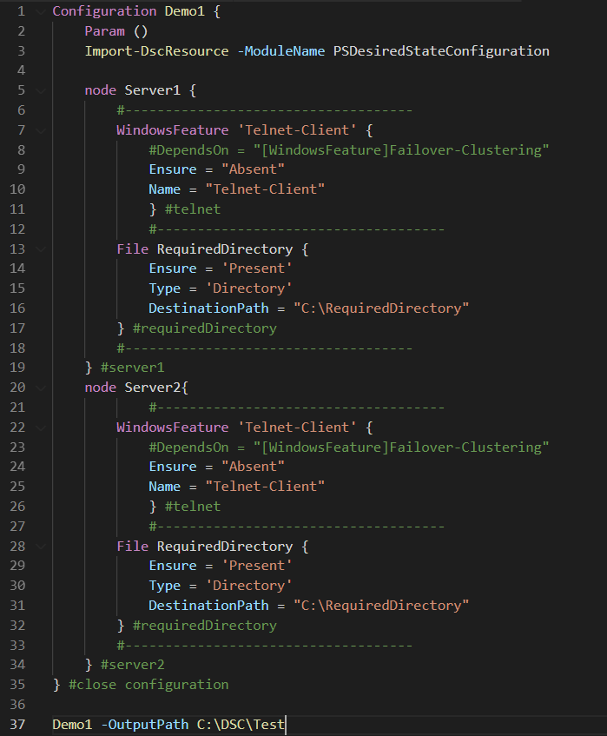
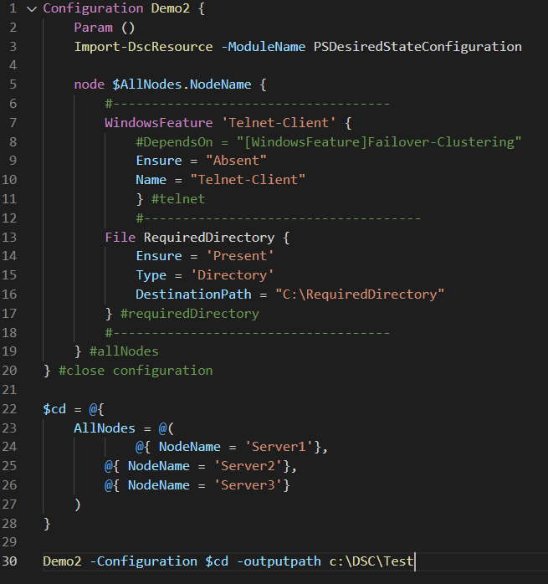
Benefits of Configuration Data
Fat Edition
Diet Edition

Slide 12

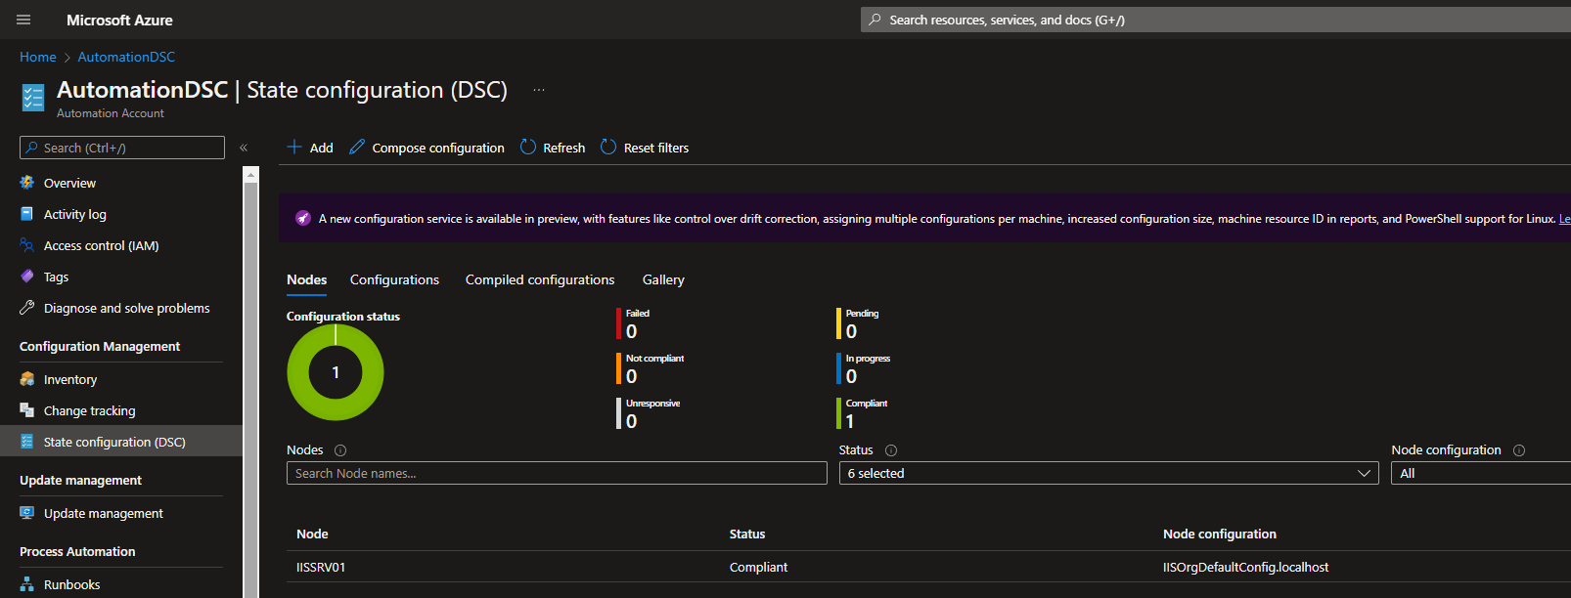
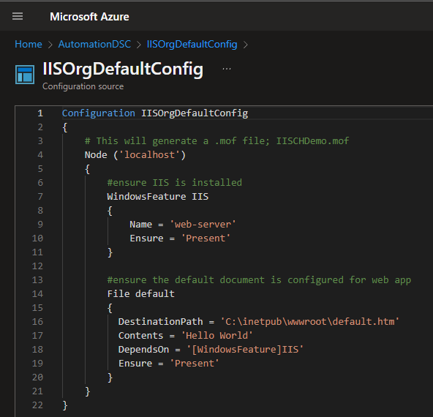
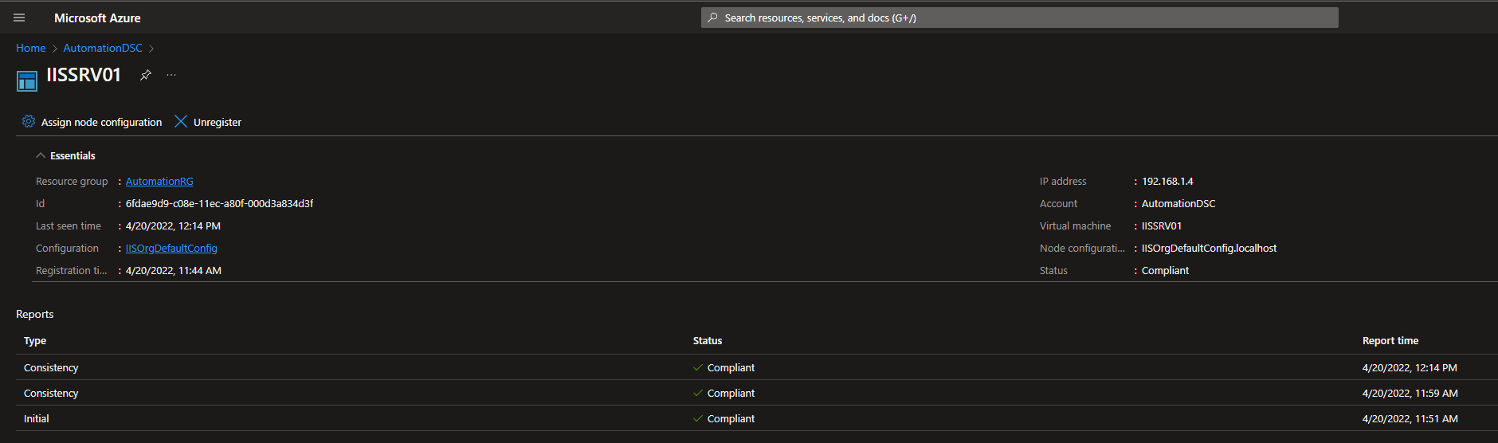
The Evolution: Azure Automation DSC
Requirements
- WMF 5.1
- WinRM *(Windows 2012 R2)
Supported Environments
- Azure Virtual Machines
- Physical/virtual Windows machines on-premises, or in a cloud other than Azure
- Physical/virtual Linux machines on-premises, in Azure, or in a cloud other than Azure
Built-In Reports!

Slide 13
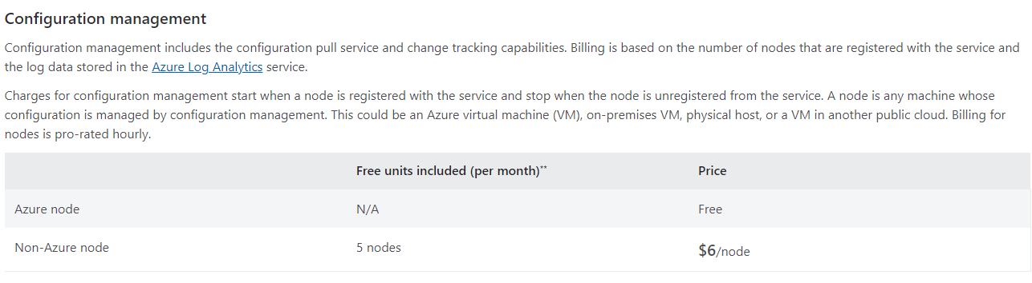


The Evolution: Azure Automation DSC Pricing
*price not applicable to Azure GOV Tenant (US)
Non-Azure node – Price Breakdown
Charge takes effect when a node communicates with the Automation Service
Pulling Config
Pulling Resources
Sending Reports
1 month = 730 hours
6$ / 730hrs = $0.0083 x hour
LCM Default values
ConfigurationModeFrequencyMins = 15
RefreshFrequencyMins = 30

Slide 14
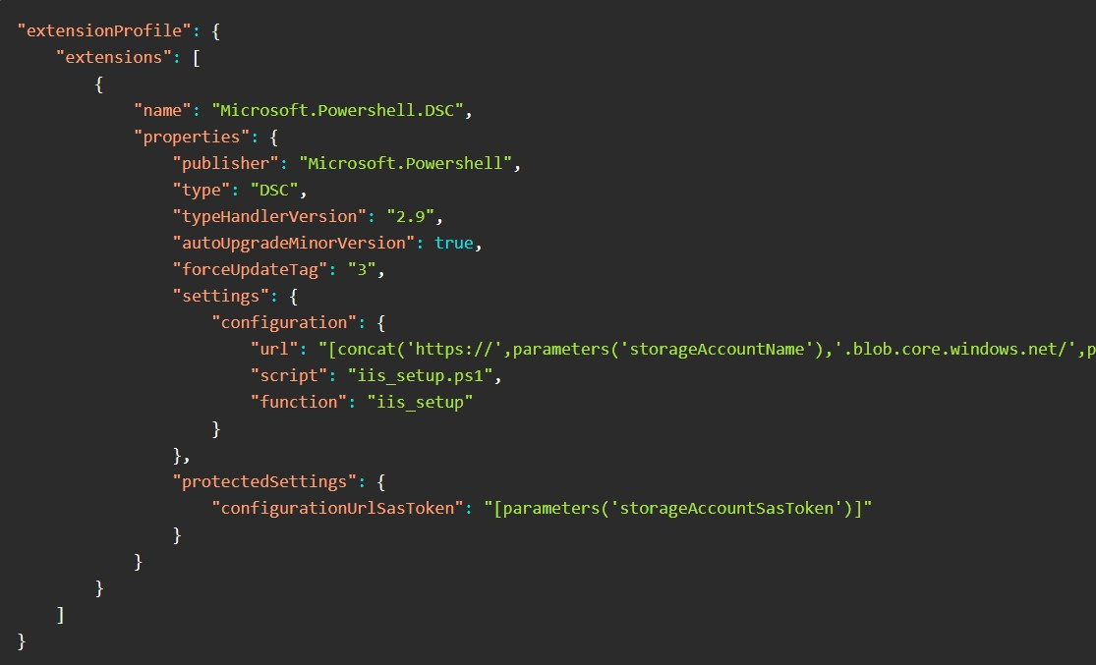
The Evolution: Azure Resource Manager (ARM) Template + DSC Extension

Slide 15

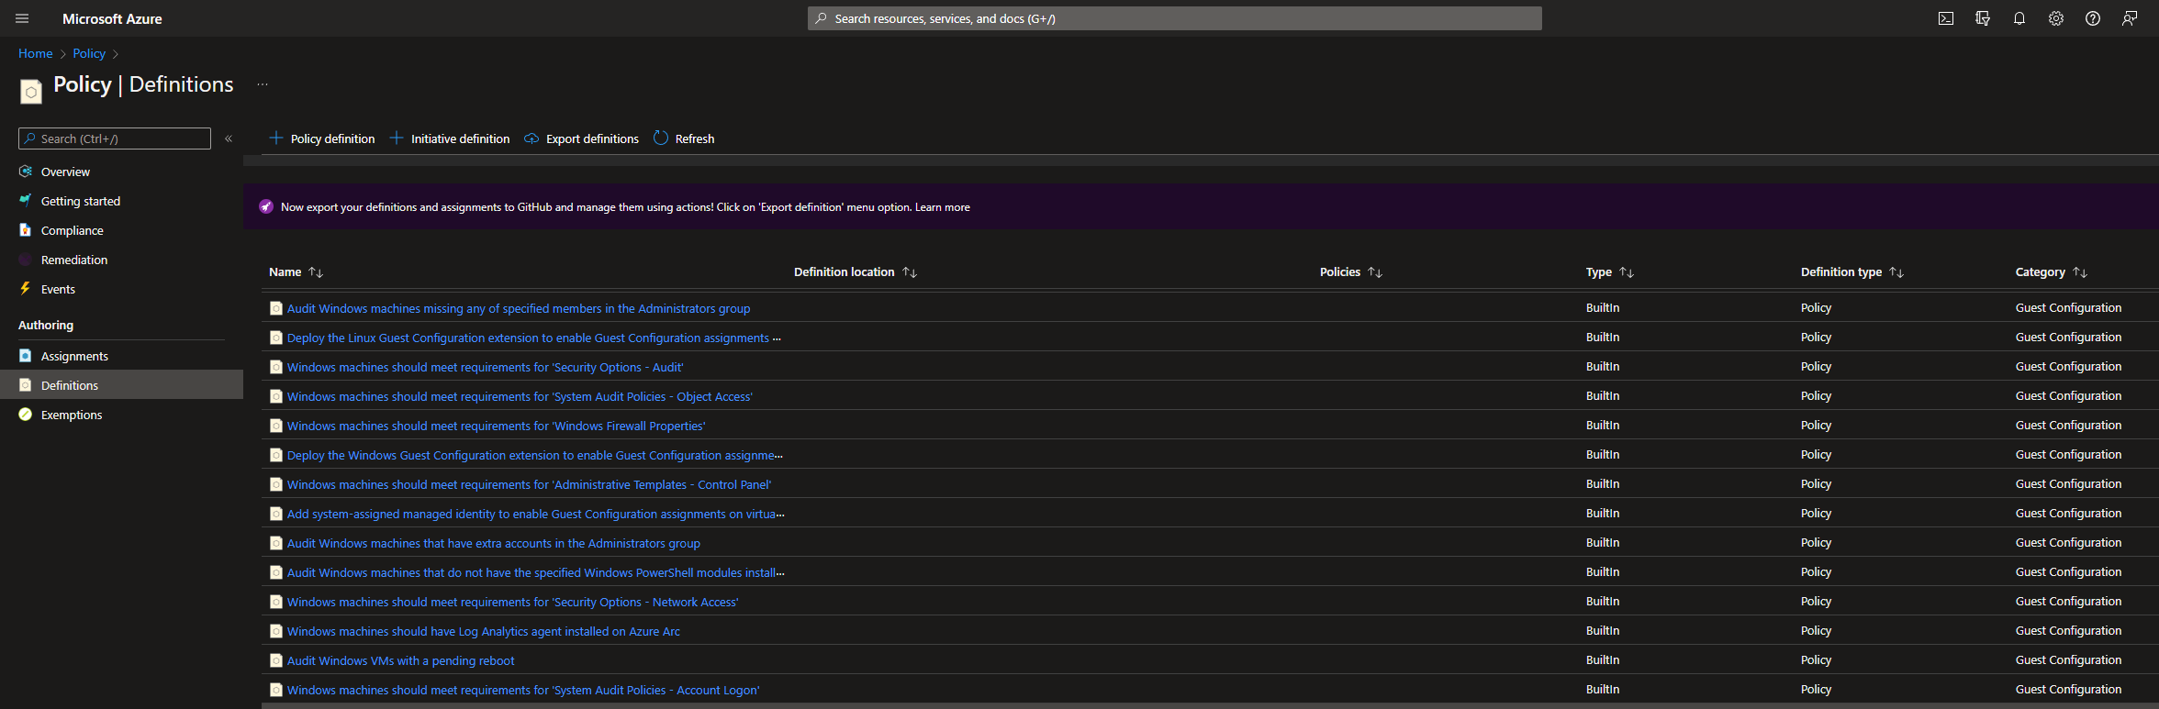
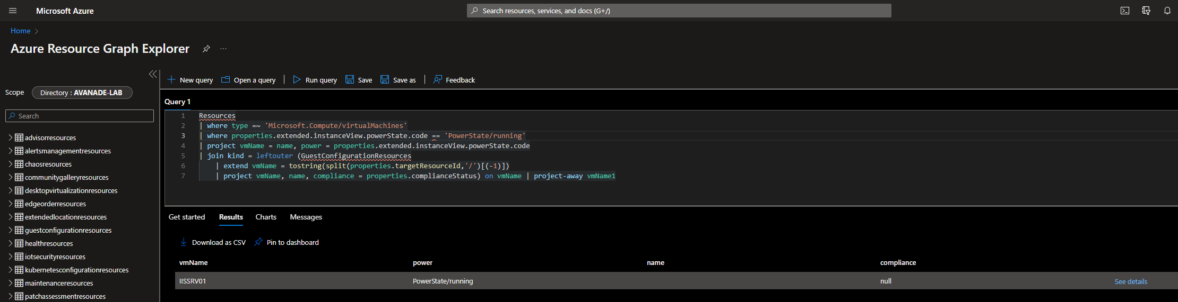
The Next Gen: Azure Policy Guest Configuration
Enhancements
- DSCv3!
- Advanced Reporting (Azure Resource Graph)
- Multiple Configurations applicable
- Size Limit increased to 100MB (before compression)
Supported Scenario
- Fully Integrated with Azure Arc
- *Migrating from AADSC to the new service (*.NET Core compatibility risk!)
- Migrating from “classic” GPOs to Policy Guest Configuration

Slide 16
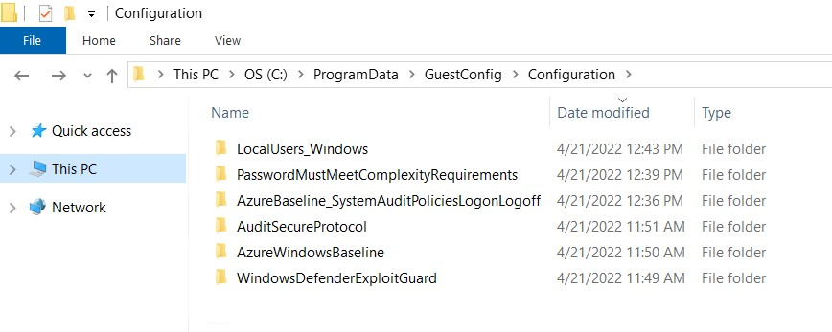
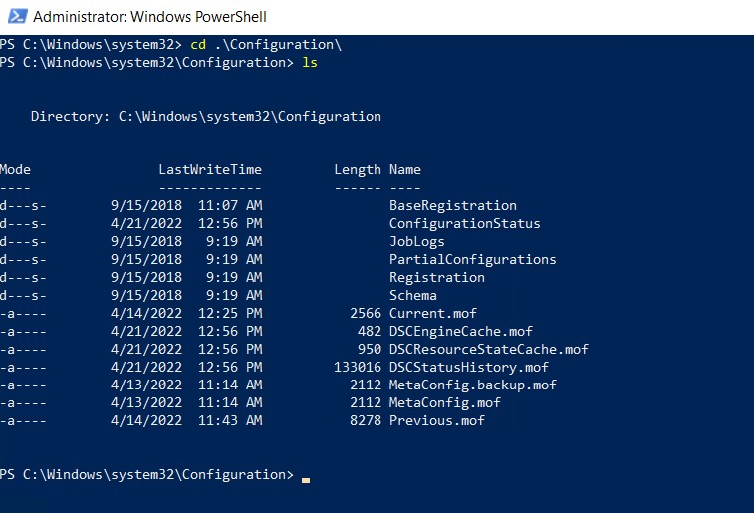
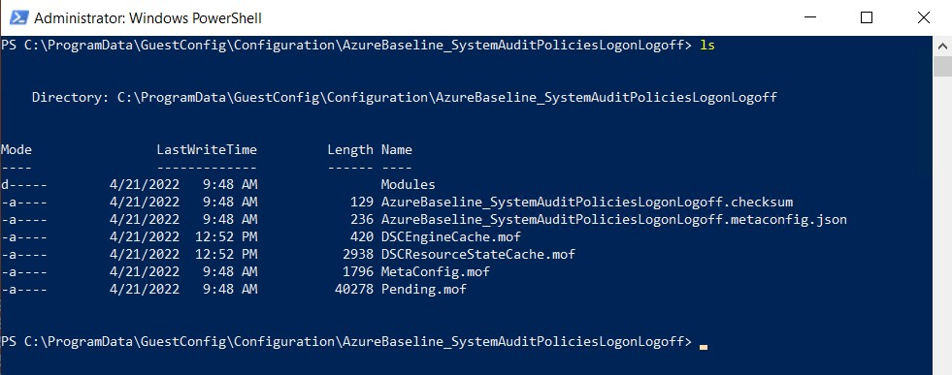
The Next Gen: Azure Policy Guest Configuration Major Changes
Root Folder Structure
Previous Gen Structure
All Package Components

Slide 17
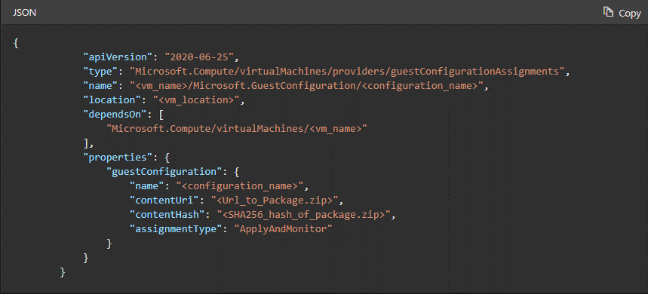
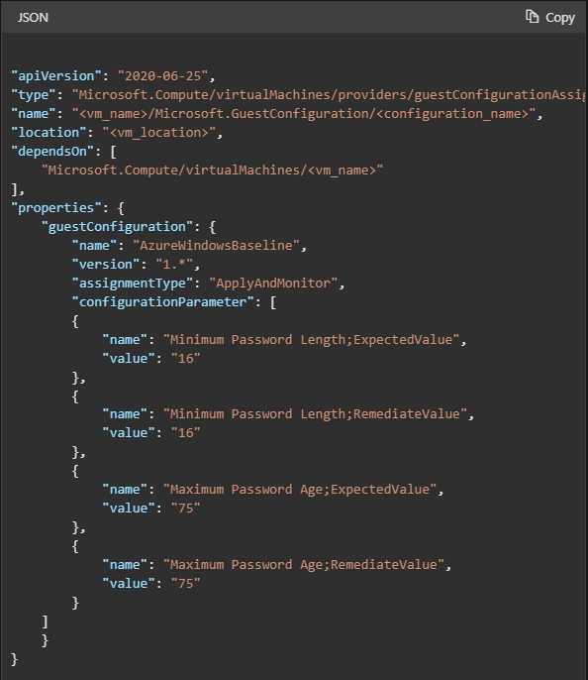
The Next Gen: Azure Resource Manager (ARM) Template + Guest Configuration
Custom Configuration
Built-In Configuration

Slide 18

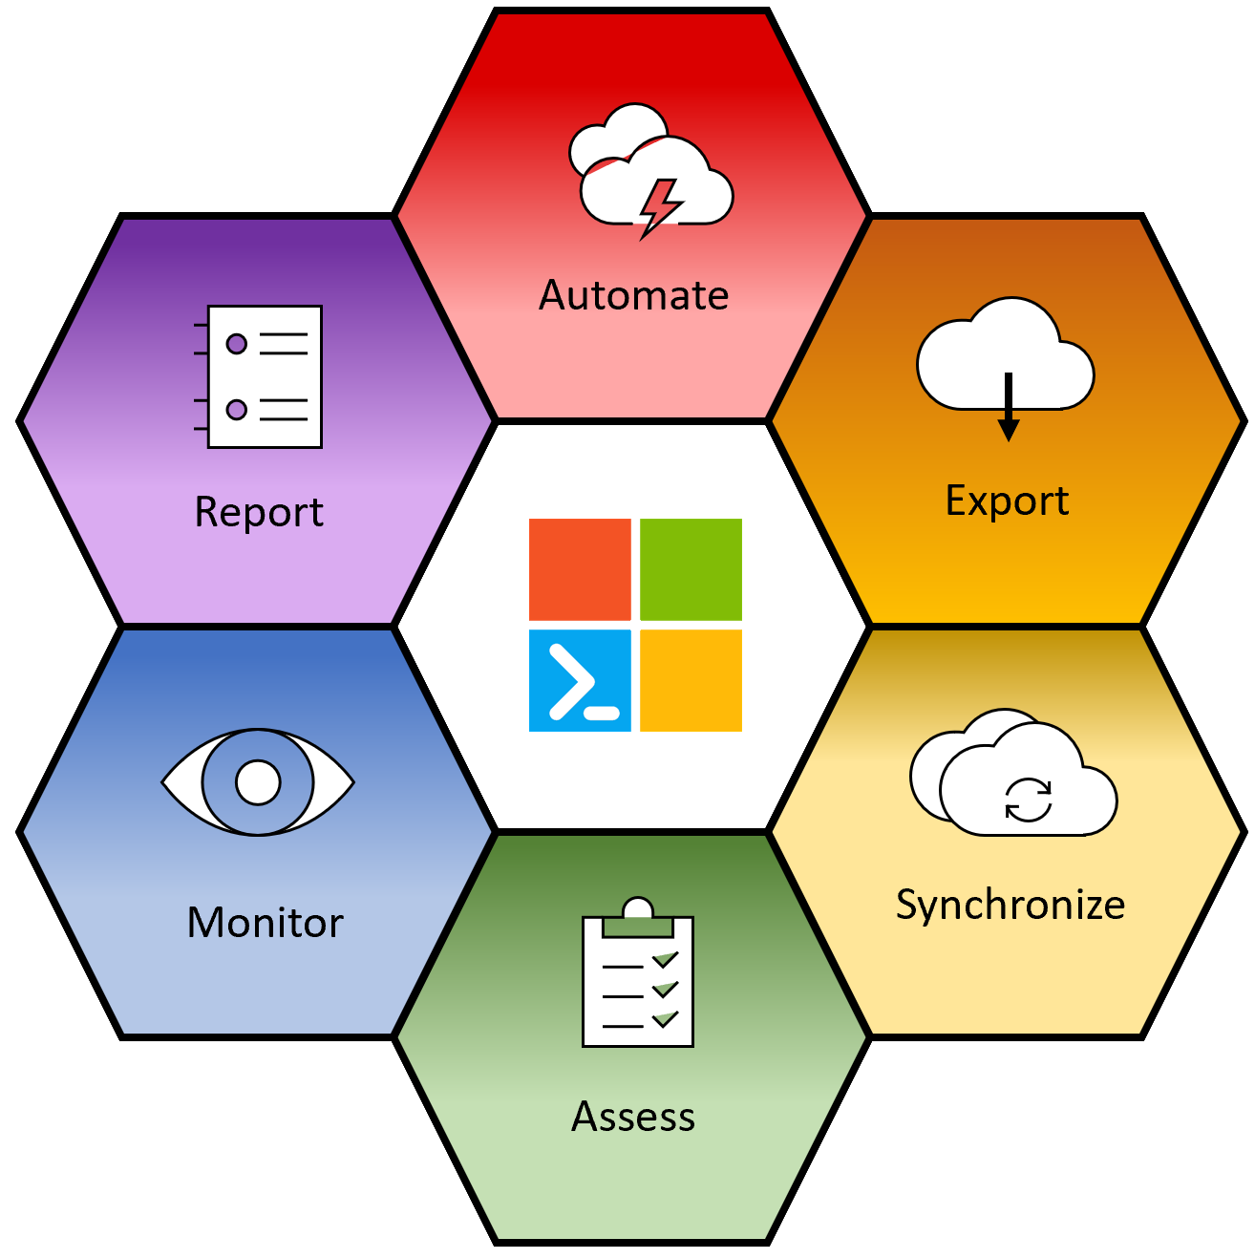
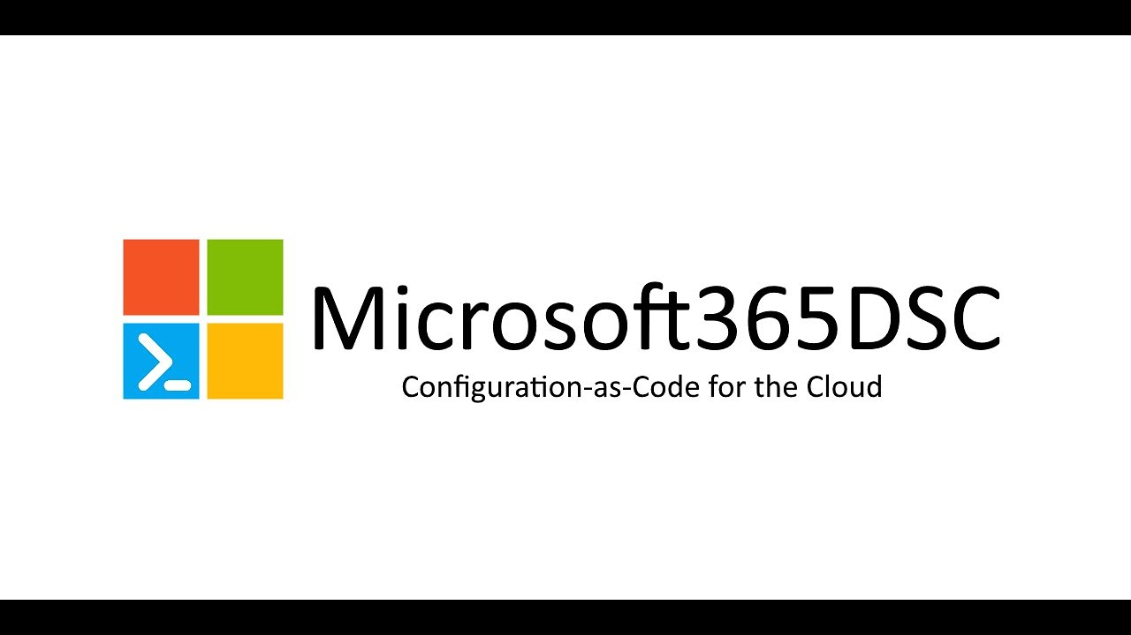
M365DSC Toolkit
“Open-Source tool managed by Microsoft engineers and lead by the community”
@NikCharlebois – MSFT Senior Program Manager
https://aka.ms/M365DSC

Slide 19
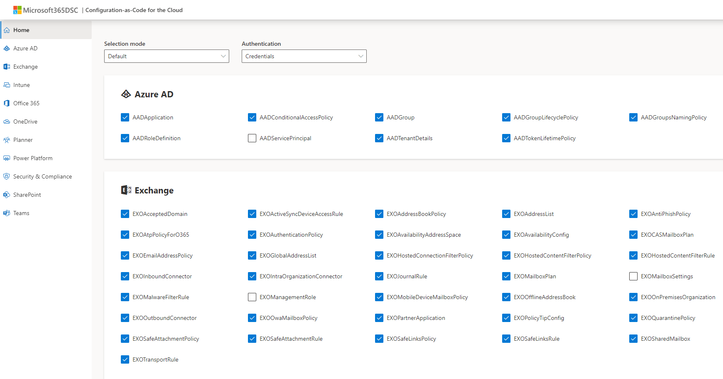
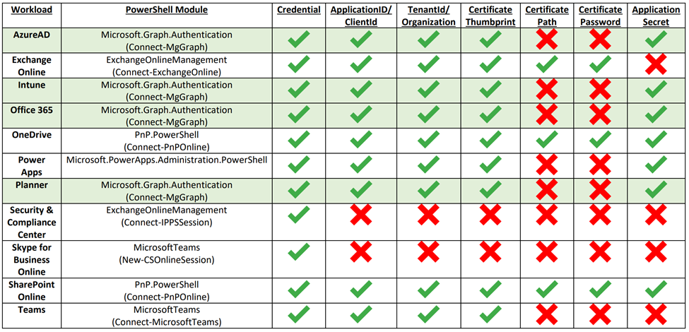
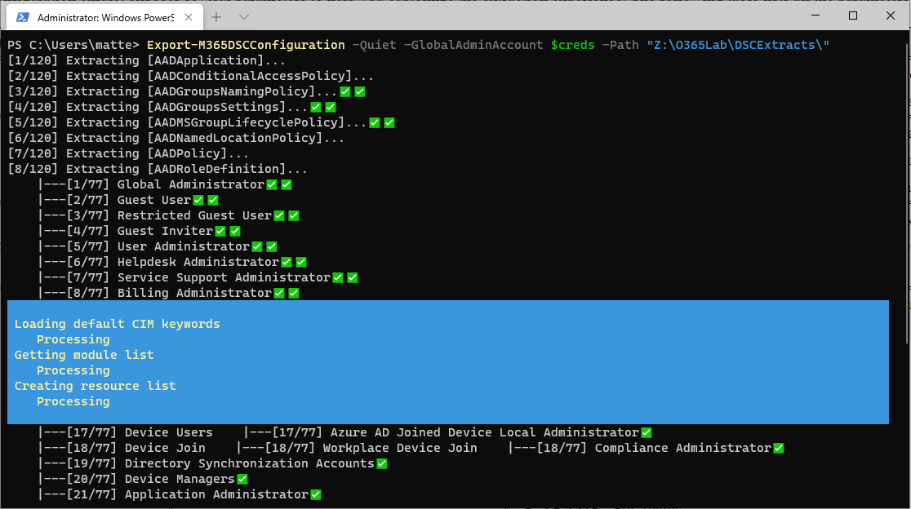
M365DSC Workload and supported Authentication
https://Export.Microsoft365DSC.com

Slide 20
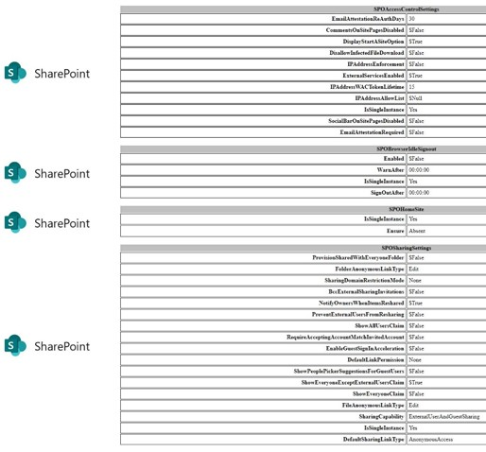
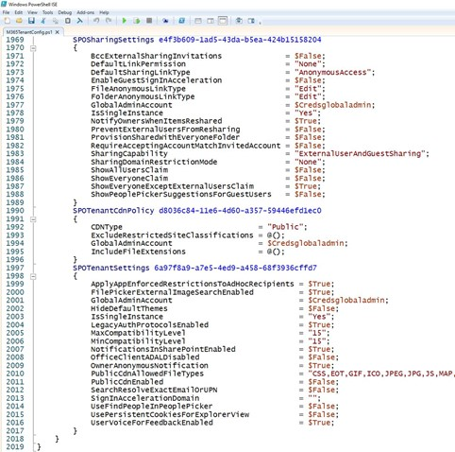
M365DSC Report sample

Slide 21

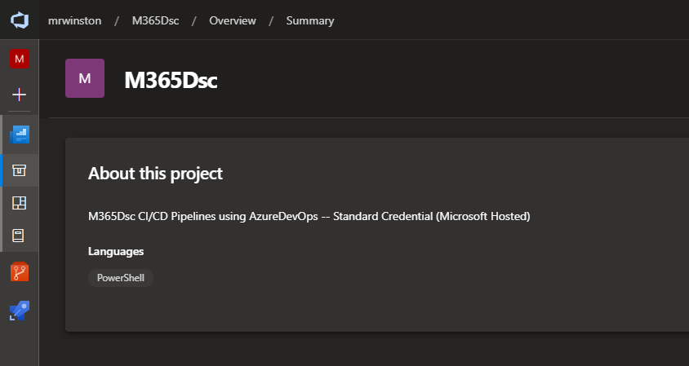
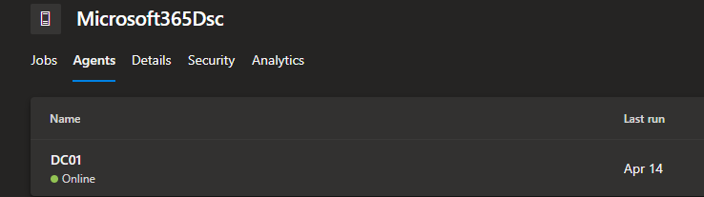
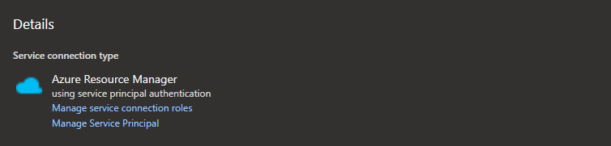
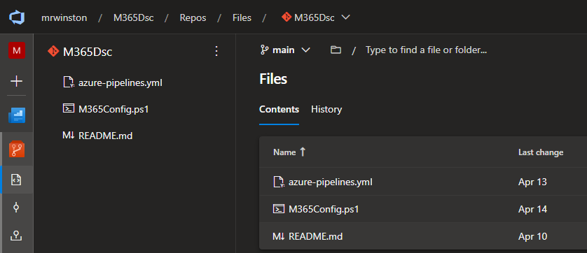
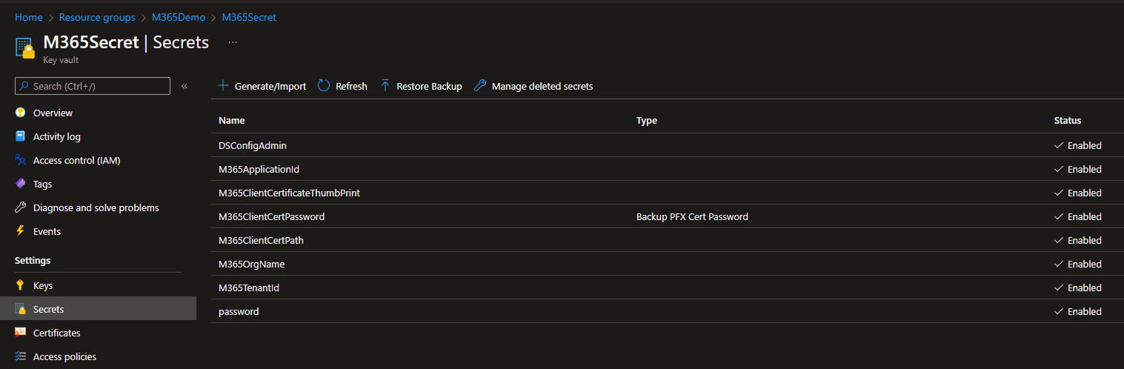
AzureDevOps Integration for CI/CD
AzureDevOps Project
https://dev.azure.com
(Self-Hosted Agent)
(Service Connection)
(Azure Key Vault)

Slide 22

Resources
The DSC Community:
DSC Community
Microsoft365DSC:
Microsoft365DSC
MSFT Docs:
MSFT - Azure Policy for Guest Configuration
MSFT QuickStart:
Convert Group Policy into DSC
GitHub Demo Repository:
M365 Virtual Marathon 2022 session

Slide 23


Q&A

